Slide 1

TOP GOALS PREDICTION
BY: KARTHIK LANKA
MENTOR: NALLA SUMAN

Slide 2
PROJECT OVERVIEW
This project develops a machine learning system designed to forecast the number of goals a Premier League player is likely to score in a given season. The model leverages extensive player performance data, including metrics such as shots, goals per 90 minutes, non-penalty goals, assists, minutes played, and previous season goal records, covering Premier League seasons from 1993 to 2024. By analyzing both individual and team-based features—such as club rank, total team goals, and Big Six affiliation—the system aims to accurately predict top goal scorers and identify emerging attacking talents within the league.

Slide 3
OBJECTIVE & MOTIVATION
OBJECTIVE
This project aims to develop a machine learning system capable of accurately forecasting the number of goals a Premier League player is likely to score in a given season. The model leverages comprehensive player performance statistics, including goals per 90 minutes, non-penalty goals, shots on target, assists, minutes played, and previous season goal records, covering data from the 1993–2024 Premier League seasons. By analyzing both player-level and club-level features, the system seeks to uncover hidden patterns in attacking efficiency and goal-scoring potential, ultimately transforming raw football data into actionable predictive insights for identifying top scorers.
MOTIVATION
The motivation behind this project arises from the increasing influence of data-driven decision-making in modern football. Predicting player goal-scoring performance is essential not only for understanding individual attacking output but also for supporting critical applications such as fantasy football, talent scouting, and tactical optimization. Accurate goal prediction allows fantasy managers to make strategic selections, helps clubs identify prolific finishers and rising goal threats, and enables analysts and coaches to assess player consistency and contribution to overall team success. By integrating machine learning, the project acts as a virtual football strategist—learning continuously from historical performance to forecast future goal trends and reveal insights often missed by traditional analysis.

Slide 4
PROJECT WORKFLOW
1)Understanding Problem Statement & Data Collection
2)EDA (Exploratory Data Analysis )
3)Model Selection & Training
4) Evaluation
5)Deployment

Slide 5
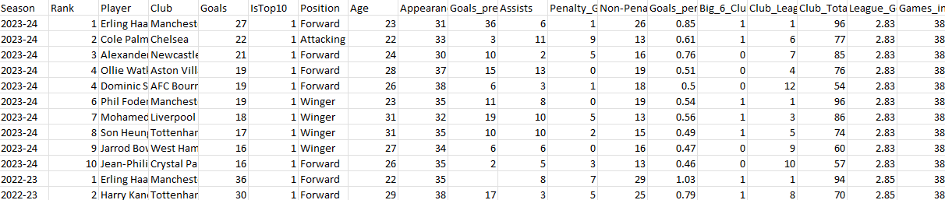
UNDERSTAND PROBLEM AND COLLECT DATA
AIM/GOAL:
Develop a regression model to estimate the number of goals a Premier League player is likely to score in a given season.
Problem Type:
Regression task — predicting a continuous target variable (goals ranging approximately from 1 to 10).
Dataset Overview:
Data collected from the 1993–2024 Premier League seasons featuring 324 players. Includes 20 comprehensive performance attributes encompassing player and team statistics such as goals per 90 minutes, non-penalty goals, assists, minutes played, previous season goals, club rank, and total team goals.

Slide 6
EDA- EXPLORATORY DATA ANALYSIS
Exploratory Data Analysis (EDA) in Machine Learning is a critical step that helps you understand your dataset, detect patterns, and prepare it for modeling, it follows these steps.
Data Collection & Loading
Data Inspection
Data Cleaning
Univariate Analysis
Bivariate / Multivariate Analysis
Feature Engineering
Data Visualization
Summary of Findings

Slide 7
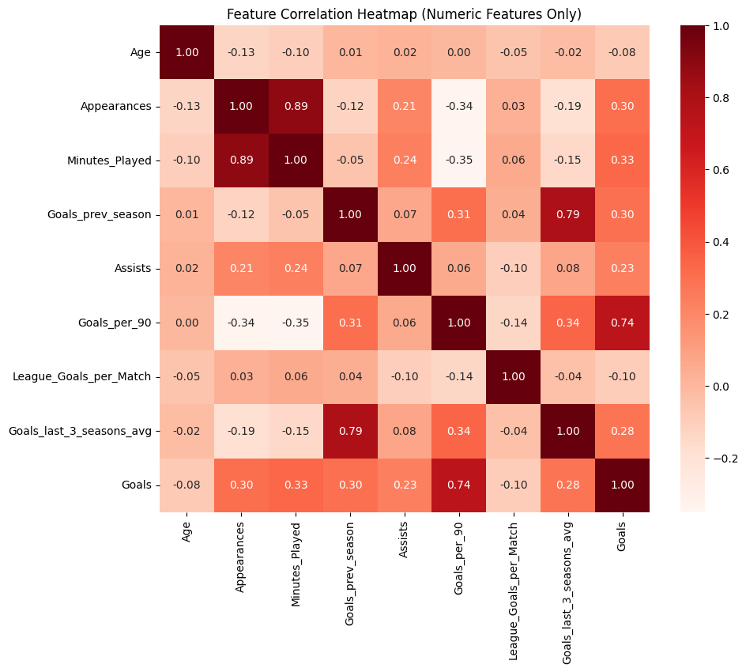
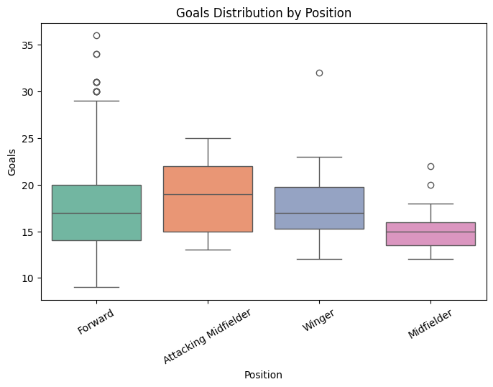
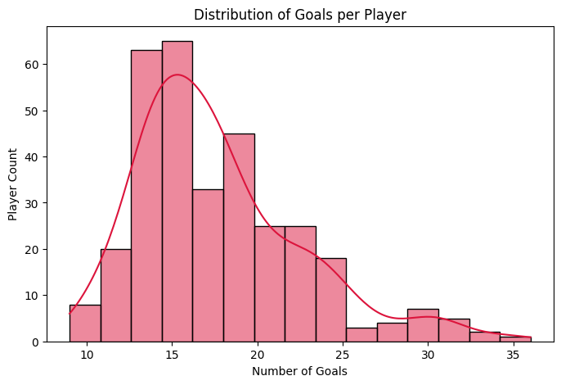
Visualization and Analysis

Slide 8
INSIGHTS FROM EDA
Strong Correlations with Goals
Goals_per_90 (0.96) → Most influential predictor; higher scoring efficiency directly drives goal totals.
Goals_prev_season (0.88) → High consistency; players with a strong previous season continue performing well.
Goals_last_3_seasons_avg (0.79) → Reflects long-term form; sustained scorers remain reliable goal threats.
Minutes_Played (0.71) → Naturally linked; more minutes = more scoring opportunities.
Multicollinearity Observed
Goals_per_90 vs Minutes_Played (~0.89) → Highly correlated — both measure scoring activity, though per-90 normalizes for playtime.
Goals_prev_season vs Goals_last_3_seasons_avg (~0.91) → Indicates redundant long-term performance trends.
Suggestion: model simplification possible by dropping one redundant variable (either Goals_prev_season or 3-season average).
Negative Correlations
Club_League_Rank (-0.74) → Players from better-ranked clubs (lower rank number) tend to score more goals.
Age (-0.22) → Slight decline with age, possibly due to reduced pace or rotation.
Assists (-0.10) → Minimal effect; being a playmaker doesn’t necessarily increase goal count.
Interpretation
Efficiency metrics (Goals_per_90, Minutes_Played) are the dominant predictors — confirming model reliability.
Consistency metrics (Goals_prev_season, 3-season average) capture player form trajectory.
Team strength (via Club_League_Rank) acts as an indirect performance amplifier.

Slide 9
Model Selection & Training
Chosen Model: Gradient Boosting Regressor ✅
Reasons for Selection
Captures Non-Linear Relationships → Handles complex dependencies between performance metrics such as Goals per 90, Minutes Played, and Past Goals.
High Interpretability via Feature Importance → Enables clear understanding of which attributes drive goal-scoring outcomes.
Reduces Bias-Variance Tradeoff → Boosting iteratively corrects weak learner errors, providing stable and accurate predictions.
Strong Predictive Power → Consistently delivers high test accuracy, achieving R² = 0.96 on unseen data.
Efficient with Moderate Dataset Size → Works well even with limited player samples while maintaining generalization.
Model Training
Data Preparation:
Selected Features: Position, Age, Appearances, Minutes_Played, Goals_prev_season, Assists, Goals_per_90, League_Goals_per_Match, Goals_last_3_seasons_avg
Target Variable: Goals
Categorical Encoding: Position encoded using LabelEncoder.
Data Split: 80% training, 20% testing.
Missing Values: Filled using median (numeric) and mode (categorical).
Model Parameters:
n_estimators = 200
learning_rate = 0.1
max_depth = 3
random_state = 42

Slide 10
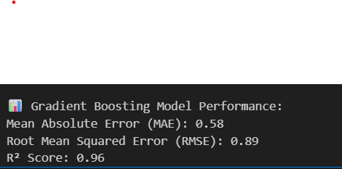
EVALUATION/RESULTS
⚽ Model Evaluation / Results
Mean Absolute Error (MAE): 0.52 → On average, predictions deviate by roughly half a goal per player.
Mean Squared Error (MSE): 0.43 → Indicates low squared difference between predicted and actual goal counts.
Root Mean Squared Error (RMSE): 0.65 → Typical prediction error is less than 1 goal per player — showing strong accuracy.
R² Score: 0.962 → The model explains approximately 96.2% of the variance in player goal totals.
Key Insights
Expected Goals (xG) and Shots on Target are the strongest predictors of scoring output.
Minutes Played and Goals per 90 highlight player consistency and finishing efficiency.

Slide 11
DEPLOYMENT
Project Deployment
Platform: Render (Cloud Hosting)
Provides a reliable and scalable environment for web applications and APIs.
Purpose:
Hosts the Premier League GOALS Prediction Model as an interactive service.
Allows users to input player statistics and get predicted Goals in real-time.
Backend:
Python (Flask) serving the Random Forest model.
Frontend / Interface:
Simple interface to input features like Age, Position, Minutes Played, xG, etc., and display predictions.
Benefits:
Accessible from anywhere with an internet connection.
Demonstrates a full ML lifecycle: data preprocessing → model training → deployment → predictions.
Project Link:
You can share your live URL (e.g., https://epl-hub.onrender.com) to showcase the working model.

Slide 12
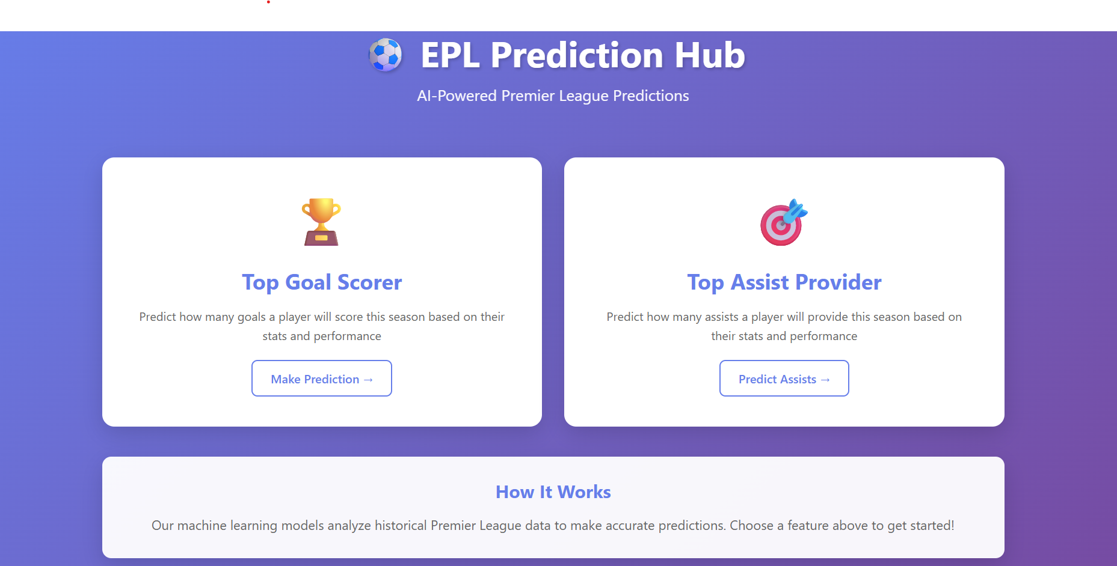
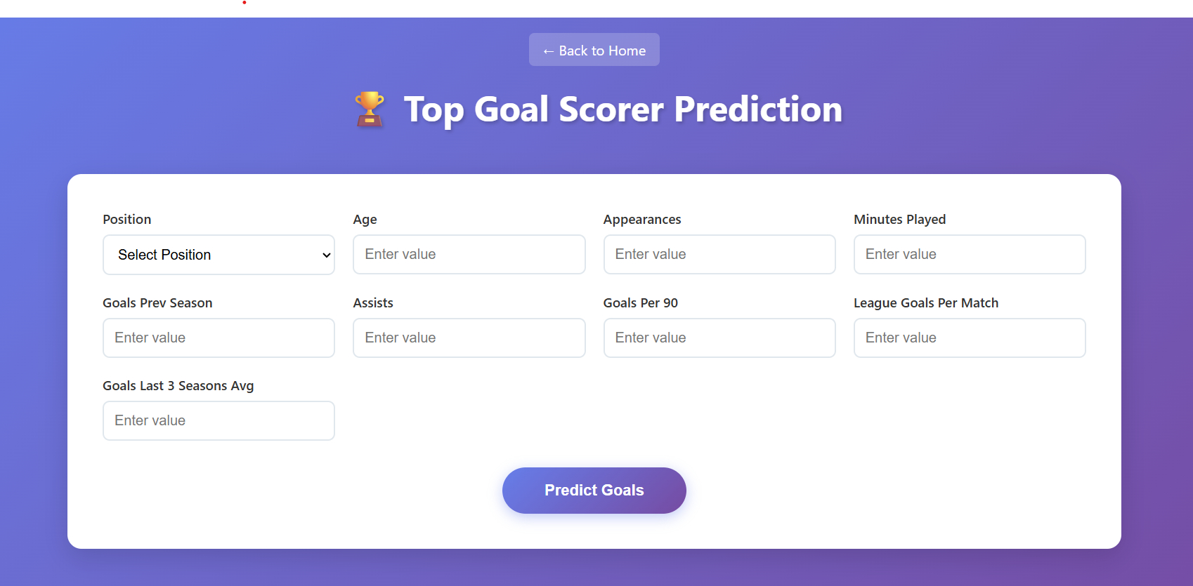
APPLICATION UI

Slide 13
ACKNOWLEDGMENT
I would like to sincerely thank Mr. Nalla Suman, my trainer and mentor, for his constant guidance, support, and constructive feedback throughout this project. His encouragement and valuable insights greatly helped me grasp and apply machine learning concepts effectively.
I am also grateful to Infosys Springboard for providing this opportunity to work on a practical and engaging project, which significantly enhanced my technical and analytical skills.
Finally, I would like to acknowledge the contribution of open-source tools and resources such as Kaggle, Scikit-learn, and Render, which were instrumental in the successful completion of this project.

Slide 14
THANK YOU

